Slide 1
EE2211 Tutorial 3
(remember to sign your attendance on the sheet of paper)

Slide 2
Lecture recap

Slide 3
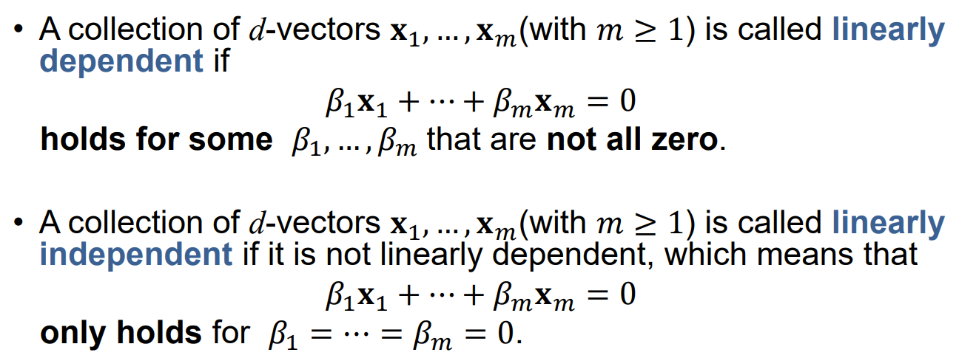
LINEAR DEPENDENCE and independence

Slide 4
Rank of matrix
The rank is how many of the rows are "unique": not made of other rows or columns
Can calculate it through finding the row echelon form
Row echelon form
All zero rows of A occur below every non-zero row of A.
All other elements below in each column after the first non-zero element of each row are zeros.
The first non-zero entry in any row lies to the left of the first non-zero entry in subsequent rows.

Slide 5
Correlation vs causality
Correlation is any statistical relationship, whether causal or not, between two random variables
Causality is the influence by which one event or process (i.e., cause) contributes to another (i.e. effect)
The cause is partly responsible for the effect, and the effect is
partly dependent on the cause
Correlation =/= Causality!

Slide 6
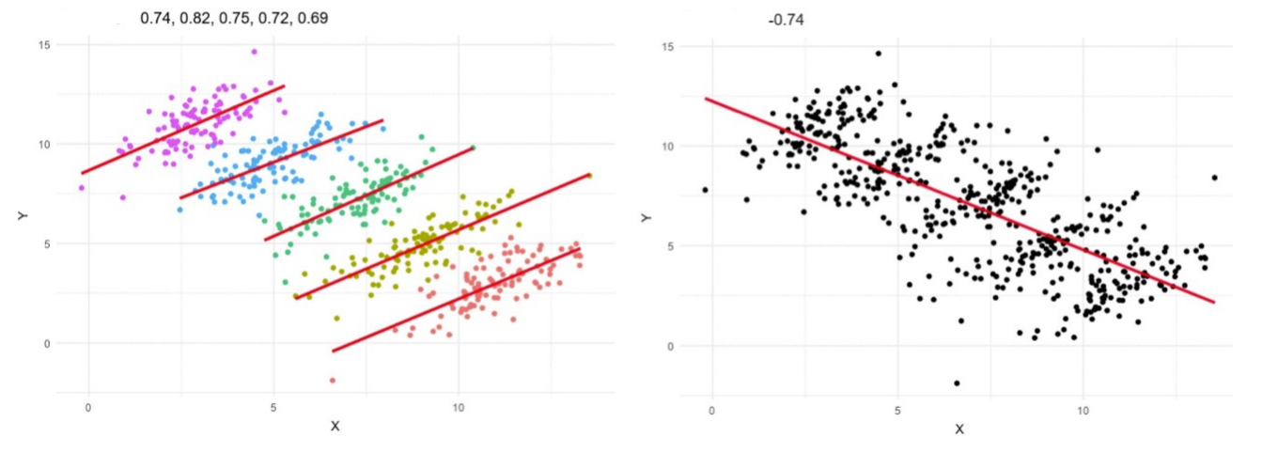
Simpson’s paradox
Simpson's paradox is a phenomenon in probability and statistics, in which a trend appears in several different groups of data but disappears or reverses when these groups are combined

Slide 7
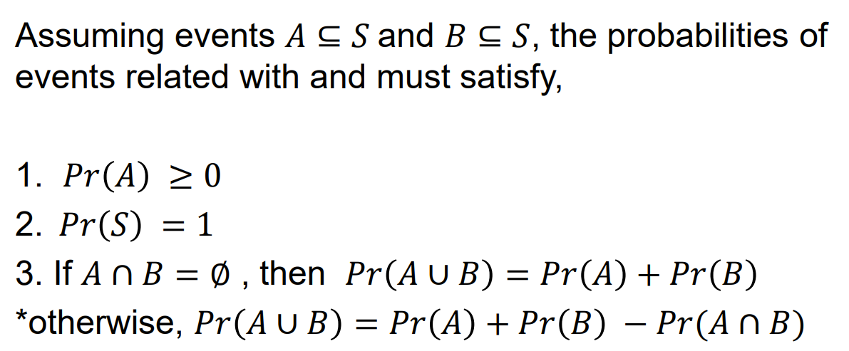
Axioms of probability

Slide 8
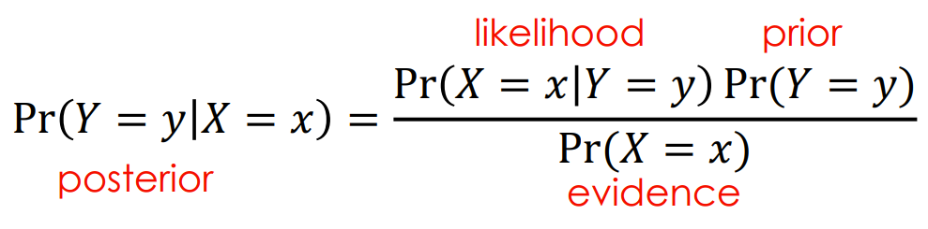
Bayes’ rule

Slide 9
Tutorial 3

Slide 10
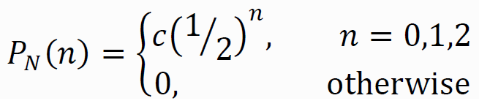
Question 1
The random variable N has probability mass function (PMF)
What is the value of the constant c?

Slide 11
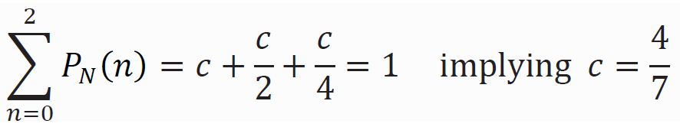
Question 1
The random variable N has probability mass function (PMF)
What is the value of the constant c?
We wish to find the value of c that makes the PMF sum up to one.

Slide 12
Question 1
The random variable N has probability mass function (PMF)
What is the value of the constant c?
We wish to find the value of c that makes the PMF sum up to one.
What is Pr[N ≤ 1]?

Slide 13
Question 1
The random variable N has probability mass function (PMF)
What is the value of the constant c?
We wish to find the value of c that makes the PMF sum up to one.
What is Pr[N ≤ 1]?
Pr [N ≤ 1] = Pr [N = 0] + Pr [N = 1] = 4/7 + 2/7 = 6/7.

Slide 14
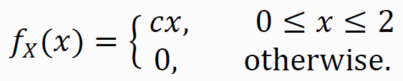
Question 2
The random variable X has probability density function (PDF)
Use the PDF to find
the constant c
Pr[0 ≤ X ≤ 1]
Pr[−1/2 ≤ X ≤ 1/2]

Slide 15
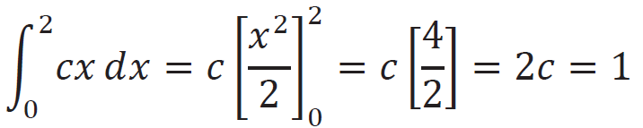
Question 2
The random variable X has probability density function (PDF)
Use the PDF to find
the constant c
Pr[0 ≤ X ≤ 1]
Pr[−1/2 ≤ X ≤ 1/2]
From the above PDF we can determine the value of c by integrating the PDF and setting it equal to 1.
Therefore c = 1/2

Slide 16
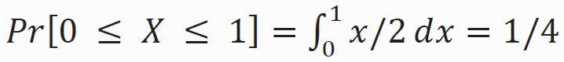
Question 2
The random variable X has probability density function (PDF)
Use the PDF to find
the constant c
Pr[0 ≤ X ≤ 1]
Pr[−1/2 ≤ X ≤ 1/2]

Slide 17
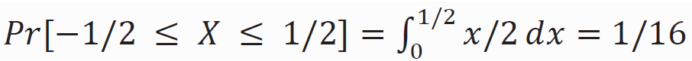
Question 2
The random variable X has probability density function (PDF)
Use the PDF to find
the constant c
Pr[0 ≤ X ≤ 1]
Pr[−1/2 ≤ X ≤ 1/2]

Slide 18
Question 3
Let A = {resistor is within 50Ω of the nominal value}. The probability that a resistor is from machine B is Pr[B] = 0.3. The probability that a resistor is acceptable, i.e., within 50 Ω of the nominal value, is Pr[A] = 0.78. Given that a resistor is from machine B, the conditional probability that it is acceptable is Pr[A|B] = 0.6. What is the probability that an acceptable resistor comes from machine B?
Bayes’ Rule

Slide 19
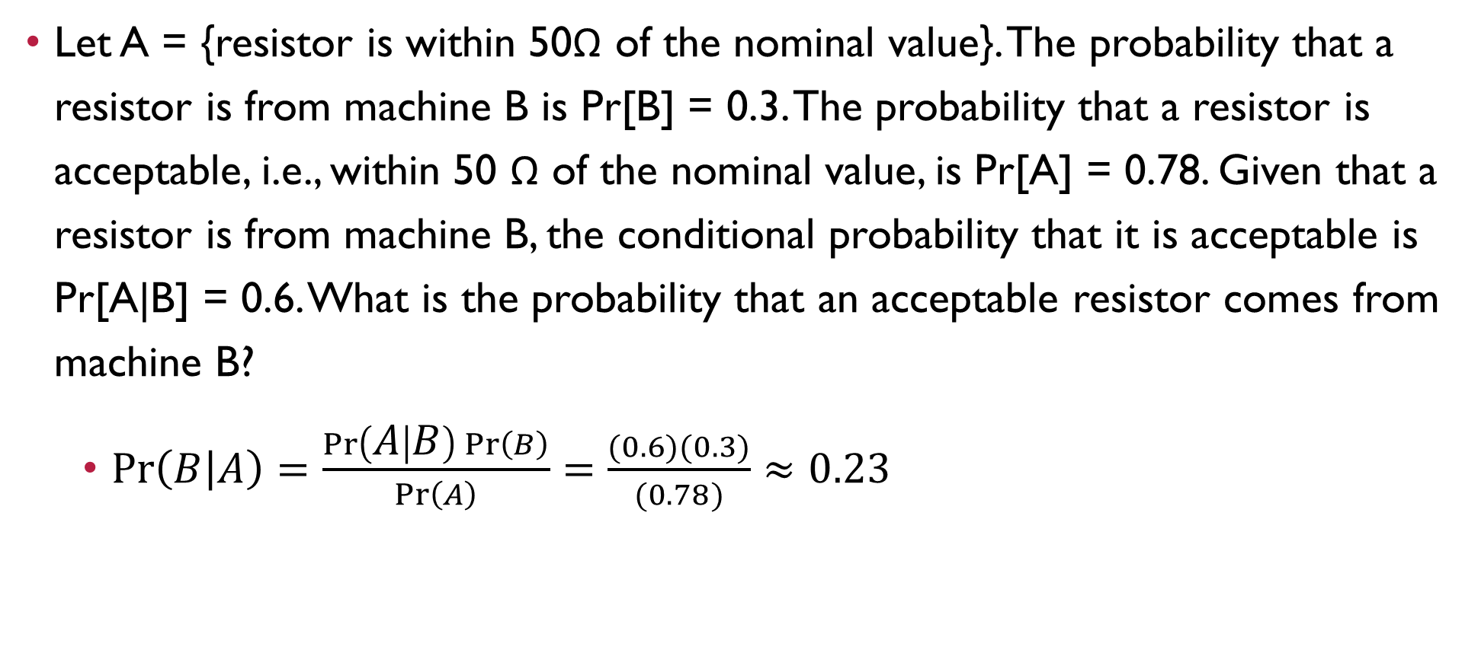
Question 3
Let A = {resistor is within 50Ω of the nominal value}. The probability that a resistor is from machine B is Pr[B] = 0.3. The probability that a resistor is acceptable, i.e., within 50 Ω of the nominal value, is Pr[A] = 0.78. Given that a resistor is from machine B, the conditional probability that it is acceptable is Pr[A|B] = 0.6. What is the probability that an acceptable resistor comes from machine B?
$\operatorname{Pr}\left(B | A\right)=\frac{\operatorname{Pr}\left(A | B\right)\operatorname{Pr}\left(B\right)}{\operatorname{Pr}\left(A\right)}=\frac{(0.6)(0.3)}{(0.78)}≈0.23$
Bayes’ Rule

Slide 20
Question 4 (Python)
Consider tossing a fair six-sided die. There are only six outcomes possible, Ω = {1, 2, 3, 4, 5, 6}. Suppose we toss two dice and assume that each throw is independent.
What is the probability that the sum of the dice equals seven?
List out all pairs of possible outcomes together with their sums from the two throws. (hint: enumerate all the items in range(1,7))
Collect all of the (a, b) pairs that sum to each of the possible values from two to twelve (including the sum equals seven). (hint: use dictionary from collections import defaultdict to collect all of the (a, b) pairs that sum to each of the possible values from two to twelve)
What is the probability that half the product of three dice will exceed their sum?

Slide 21
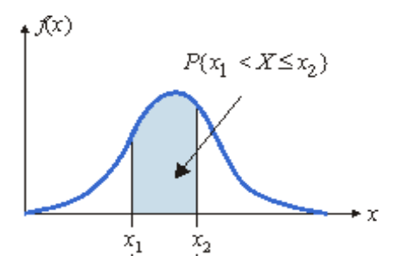
Question 5 (python)
Assuming a normal (Gaussian) distribution with mean 30 Ω and standard deviation of 1.8 Ω, determine the probability that a resistor coming off the production line will be within the range of 28 Ω to 33 Ω. (Hint: use stats.norm.cdf function from scipy import stats)

Slide 22
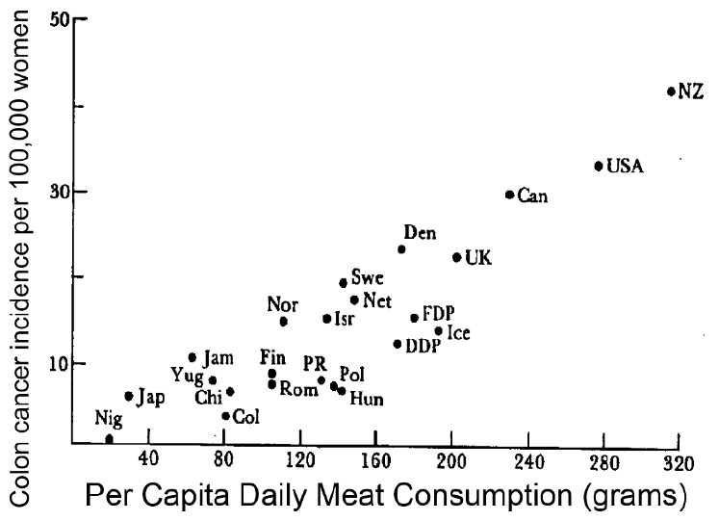
Question 6
State what you think the evidence is trying to suggest. Is there correlation or not?
Give a reason why you agree or disagree with what the evidence is suggesting.
Identify whether the variable of the y-axis and the variable of the x-axis are correlated and/or causal?

Slide 23
Question 6
State what you think the evidence is trying to suggest. Is there correlation or not?
Give a reason why you agree or disagree with what the evidence is suggesting.
Identify whether the variable of the y-axis and the variable of the x-axis are correlated and/or causal?
Colon cancer is correlated to the amount of daily meat consumption.

Slide 24
Question 6
State what you think the evidence is trying to suggest. Is there correlation or not?
Give a reason why you agree or disagree with what the evidence is suggesting.
Identify whether the variable of the y-axis and the variable of the x-axis are correlated and/or causal?
Colon cancer is correlated to the amount of daily meat consumption.
There is a clear linear trend; countries with the lowest meat consumption have the lowest rates of colon cancer, and the colon cancer rate among these countries progressively increases as meat consumption increases.

Slide 25
Question 6
State what you think the evidence is trying to suggest. Is there correlation or not?
Give a reason why you agree or disagree with what the evidence is suggesting.
Identify whether the variable of the y-axis and the variable of the x-axis are correlated and/or causal?
Colon cancer is correlated to the amount of daily meat consumption.
There is a clear linear trend; countries with the lowest meat consumption have the lowest rates of colon cancer, and the colon cancer rate among these countries progressively increases as meat consumption increases.
Causal

Slide 26
Question 7
If A and B are correlated, but they’re actually caused by C, which of the following statements are correct?
A and C are correlated
B and C are correlated
A causes B to happen
A causes C to happen

Slide 27
Question 7
If A and B are correlated, but they’re actually caused by C, which of the following statements are correct?
A and C are correlated
B and C are correlated
A causes B to happen
A causes C to happen
Yes, A and C are correlated because A is caused by C

Slide 28
Question 7
If A and B are correlated, but they’re actually caused by C, which of the following statements are correct?
A and C are correlated
B and C are correlated
A causes B to happen
A causes C to happen
Yes, A and C are correlated because A is caused by C
Yes, B and C are correlated because B is caused by C

Slide 29
Question 7
If A and B are correlated, but they’re actually caused by C, which of the following statements are correct?
A and C are correlated
B and C are correlated
A causes B to happen
A causes C to happen
Yes, A and C are correlated because A is caused by C
Yes, B and C are correlated because B is caused by C
No, A and B share the confounding factor C, but A and B don’t have causal relationship

Slide 30
Question 7
If A and B are correlated, but they’re actually caused by C, which of the following statements are correct?
A and C are correlated
B and C are correlated
A causes B to happen
A causes C to happen
Yes, A and C are correlated because A is caused by C
Yes, B and C are correlated because B is caused by C
No, A and B share the confounding factor C, but A and B don’t have causal relationship
No, C causes A to happen, however, we are not sure if A causes C to happen

Slide 31
Question 8
We toss a coin and observe which side is facing up. Which of the following statements represent valid probability assignments for observing head P[‘H’] and tail P[‘T’]?
P[‘H’]=0.2, P[‘T’]=0.9
P[‘H’]=0.0, P[‘T’]=1.0
P[‘H’]=-0.1, P[‘T’]=1.1
P[‘H’]=P[‘T’]=0.5

Slide 32
Question 8
We toss a coin and observe which side is facing up. Which of the following statements represent valid probability assignments for observing head P[‘H’] and tail P[‘T’]?
P[‘H’]=0.2, P[‘T’]=0.9
P[‘H’]=0.0, P[‘T’]=1.0
P[‘H’]=-0.1, P[‘T’]=1.1
P[‘H’]=P[‘T’]=0.5
Invalid because they sum to 1.1, which doesn’t conform to the Axioms of probability

Slide 33
Question 8
We toss a coin and observe which side is facing up. Which of the following statements represent valid probability assignments for observing head P[‘H’] and tail P[‘T’]?
P[‘H’]=0.2, P[‘T’]=0.9
P[‘H’]=0.0, P[‘T’]=1.0
P[‘H’]=-0.1, P[‘T’]=1.1
P[‘H’]=P[‘T’]=0.5
Invalid because they sum to 1.1, which doesn’t conform to the Axioms of probability
Valid because it conforms to the Axioms of probability

Slide 34
Question 8
We toss a coin and observe which side is facing up. Which of the following statements represent valid probability assignments for observing head P[‘H’] and tail P[‘T’]?
P[‘H’]=0.2, P[‘T’]=0.9
P[‘H’]=0.0, P[‘T’]=1.0
P[‘H’]=-0.1, P[‘T’]=1.1
P[‘H’]=P[‘T’]=0.5
Invalid because they sum to 1.1, which doesn’t conform to the Axioms of probability
Valid because it conforms to the Axioms of probability
Invalid because probability cannot have negative value

Slide 35
Question 8
We toss a coin and observe which side is facing up. Which of the following statements represent valid probability assignments for observing head P[‘H’] and tail P[‘T’]?
P[‘H’]=0.2, P[‘T’]=0.9
P[‘H’]=0.0, P[‘T’]=1.0
P[‘H’]=-0.1, P[‘T’]=1.1
P[‘H’]=P[‘T’]=0.5
Invalid because they sum to 1.1, which doesn’t conform to the Axioms of probability
Valid because it conforms to the Axioms of probability
Invalid because probability cannot have negative value
Valid because it conforms to the Axioms of probability

Slide 36
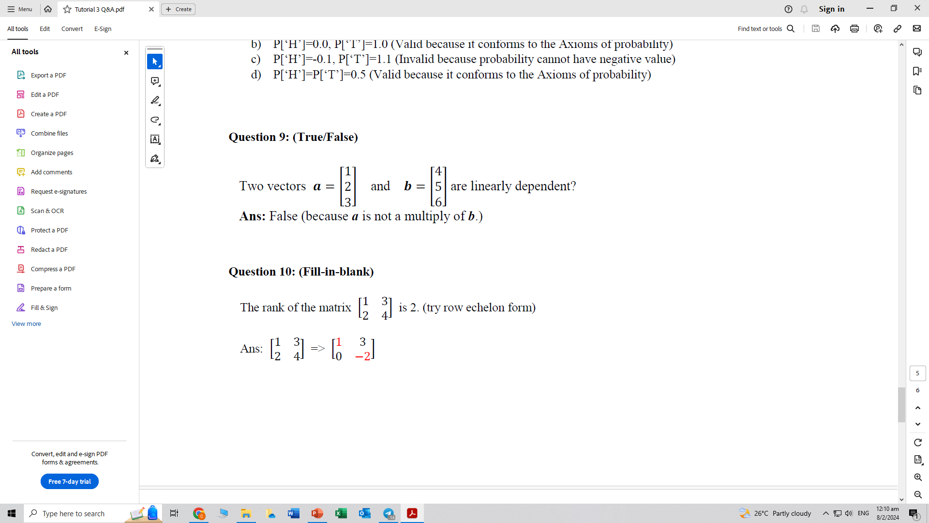
Question 9
Two vectors and are linearly dependent. True or false?

Slide 37
Question 9
Two vectors and are linearly dependent. True or false?
False, because a is not a multiple of b

Slide 38
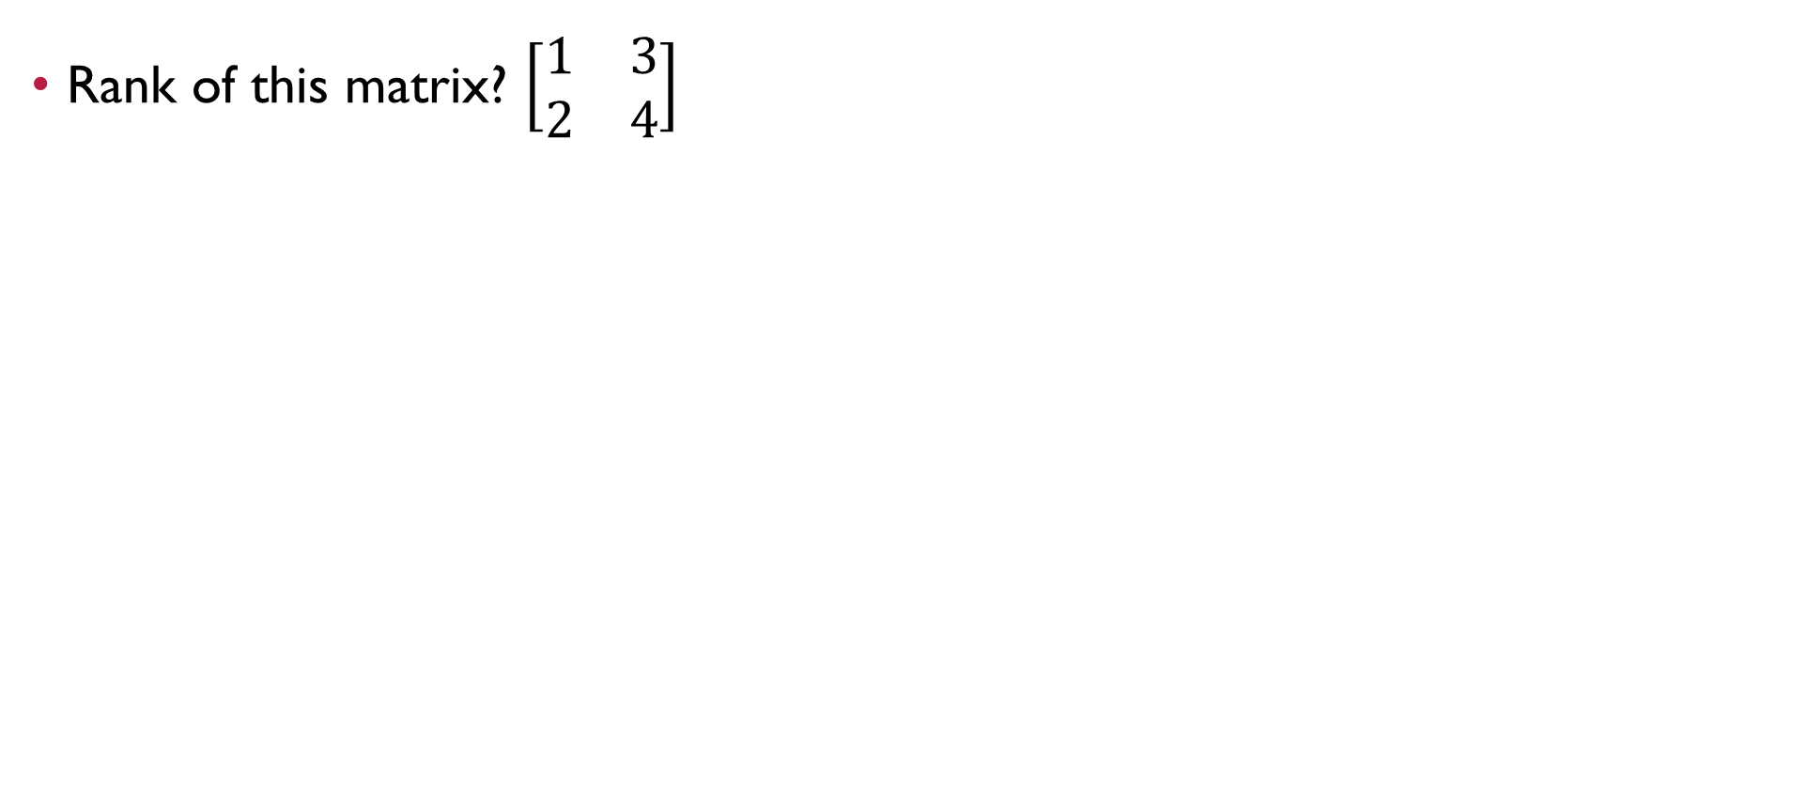
Question 10
Rank of this matrix? $\left[\begin{matrix}1 & 3 \\ 2 & 4\end{matrix}\right]$

Slide 39
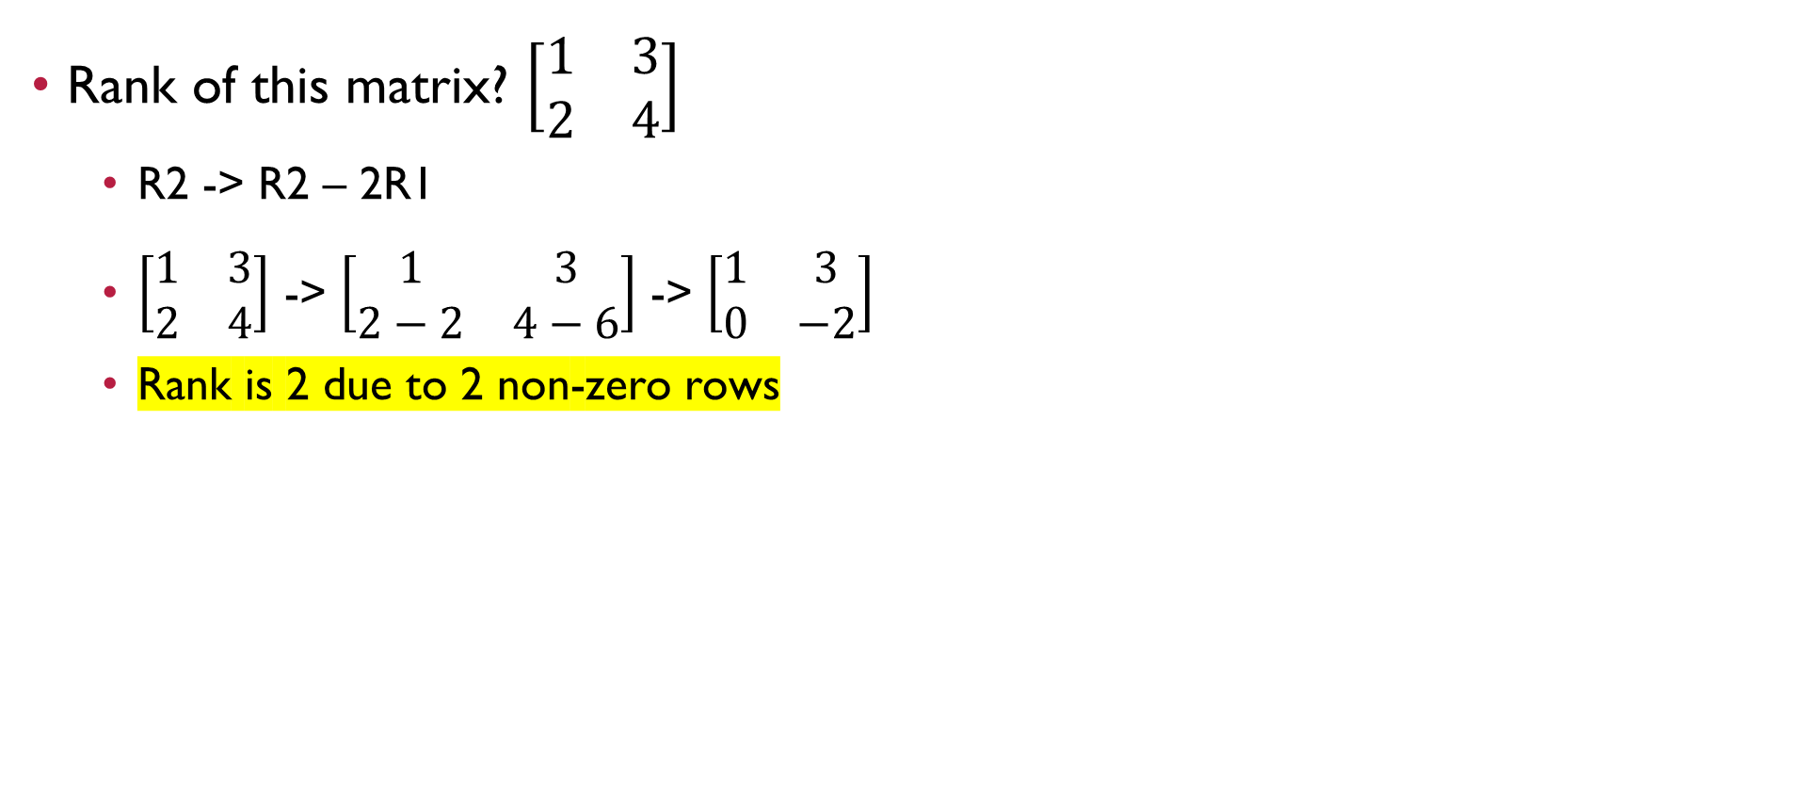
Question 10
Rank of this matrix? $\left[\begin{matrix}1 & 3 \\ 2 & 4\end{matrix}\right]$
R2 -> R2 – 2R1
$\left[\begin{matrix}1 & 3 \\ 2 & 4\end{matrix}\right]$ -> $\left[\begin{matrix}1 & 3 \\ 2−2 & 4−6\end{matrix}\right]$ -> $\left[\begin{matrix}1 & 3 \\ 0 & −2\end{matrix}\right]$
Rank is 2 due to 2 non-zero rows
Row echelon form
All zero rows of A occur below every non-zero row of A.
All other elements below in each column after the first non-zero element of each row are zeros.
The first non-zero entry in any row lies to the left of the first non-zero entry in subsequent rows.

Slide 40
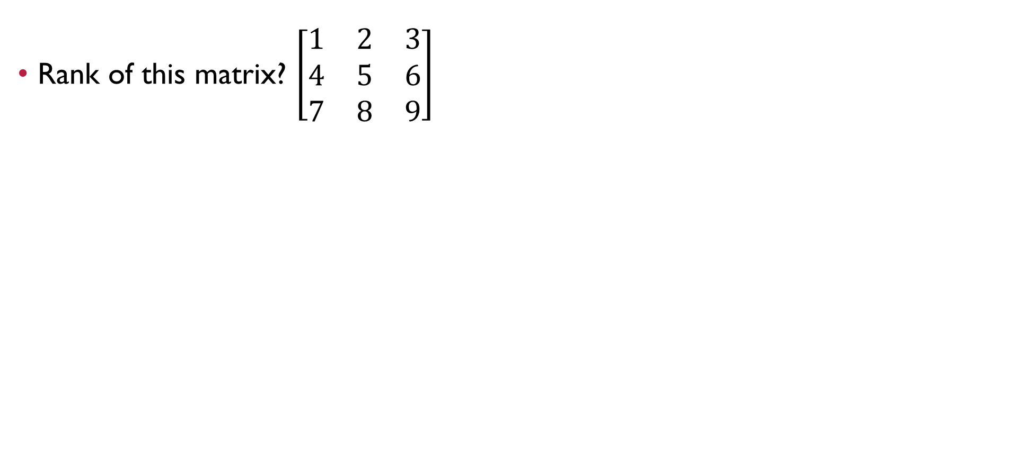
Question 11
Rank of this matrix? $\left[\begin{matrix}1 & 2 & 3 \\ 4 & 5 & 6 \\ 7 & 8 & 9\end{matrix}\right]$
Row echelon form
All zero rows of A occur below every non-zero row of A.
All other elements below in each column after the first non-zero element of each row are zeros.
The first non-zero entry in any row lies to the left of the first non-zero entry in subsequent rows.

Slide 41
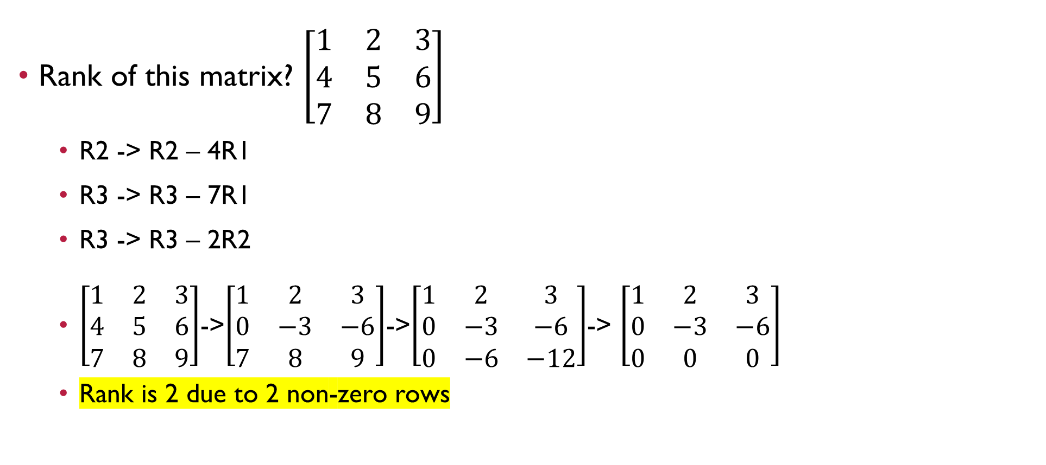
Question 11
Rank of this matrix? $\left[\begin{matrix}1 & 2 & 3 \\ 4 & 5 & 6 \\ 7 & 8 & 9\end{matrix}\right]$
R2 -> R2 – 4R1
R3 -> R3 – 7R1
R3 -> R3 – 2R2
$\left[\begin{matrix}1 & 2 & 3 \\ 4 & 5 & 6 \\ 7 & 8 & 9\end{matrix}\right]$->$\left[\begin{matrix}1 & 2 & 3 \\ 0 & −3 & −6 \\ 7 & 8 & 9\end{matrix}\right]$->$\left[\begin{matrix}1 & 2 & 3 \\ 0 & −3 & −6 \\ 0 & −6 & −12\end{matrix}\right]$-> $\left[\begin{matrix}1 & 2 & 3 \\ 0 & −3 & −6 \\ 0 & 0 & 0\end{matrix}\right]$
Rank is 2 due to 2 non-zero rows

Slide 42


Questions?
Feel free to come up to me if you have any questions about anything!
If you are shy, you can use the anonymous form to leave questions & feedback about the tutorial.
You can also reach out to me on our Telegram group or PM me at @eehongchan
Anonymous feedback
Telegram
https://forms.gle/c9QU94YcWjR3EZFk9

